Slide 1



White Hats & Password cracking
Department of Engineering, Computing, and Cybersecurity
Nate Otting
Joshua Mata
Everett Getchell
Professor: Dr. Gonzalo D. Parra

Slide 2


Content
White Hats and Importance
Important White Hats
Key Dates
Password Cracking
Conclusion • Objective • Timeline • Management System • Project Milestones • Prototype and Demo • Challenges and Limitations • Future Work • Conclusion • Resources
Purpose
Objective

Slide 3

Purpose of the project
Most often we see hackers in movies as morally questionable, but it is important to show that not all hackers are fighting to take our information, but instead to find ways to protect them.
To explore white hat hacking and its essential role in protecting digital systems with ethical hacking practices and professional hacking techniques.
White hat hackers can provide insight into what a company or body needs to do when it comes to hardening systems or networks
https://www.ecpi.edu/blog/how-to-become-a-white-hat-hacker

Slide 4
Objective
To define, explain, and give credit to white hat hackers, for making cyber security more clear, effective, and efficient, and to display how password cracking can be performed more easily than one may think and to provide insights on how to harden passwords and log ins, as well as other alternatives.

Slide 5
Timeline

Slide 6
Management System

Slide 7
Project Milestones
Research White Hats
Collect Important Dates
Test Password Cracking

Slide 8

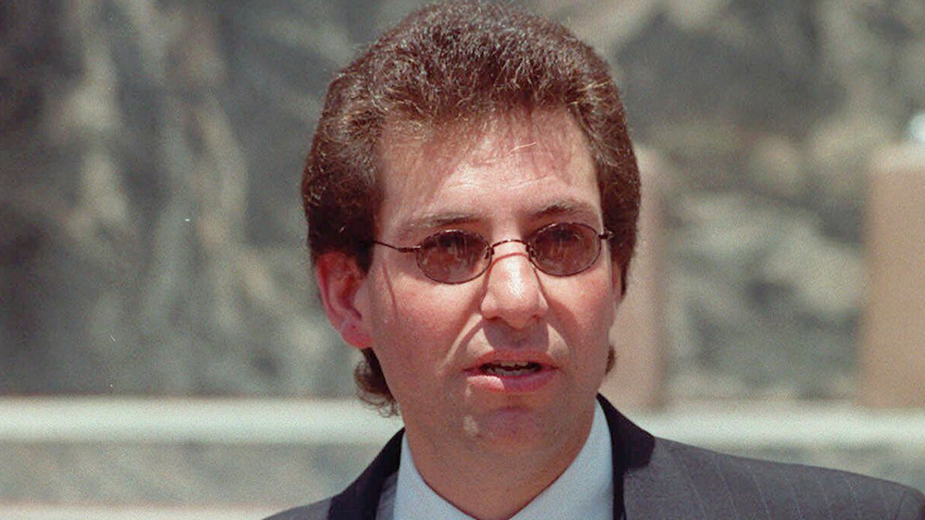
Researched White hats
-Charlie Miller
-HD Moore
-Greg Hoglund
Tsutomu Shimomura
https://www.cnn.com/2023/07/21/us/computer-hacker-kevin-mitnick-obit/index.html
Kevin Mitnick

Slide 9
Important dates for white hats

Slide 10
Password cracking

Slide 11
Prototype and Demo

Slide 12
Challenges and limitations

Slide 13
Challenges & Limitations

Slide 14
Future work

Slide 15
conclusion
Our project findings and information can be found at: https://github.com/egetche/CompSystemsSecProject

